Slide 1
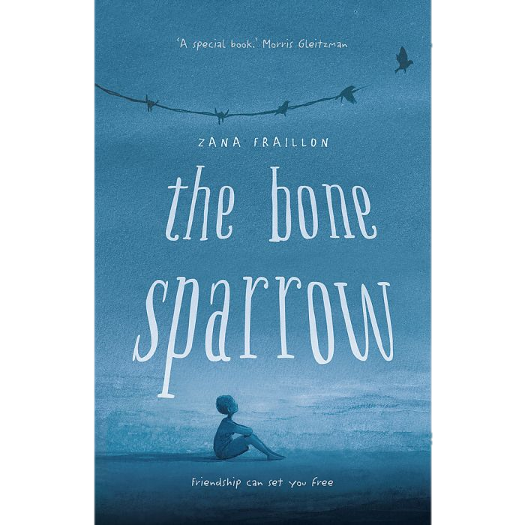
Writing the Conclusion
Text response The Bone Sparrow

Slide 2
Learning outcomes
Learning intention:
By the end of the lesson, you will have:
To be able to write a better conclusion
Written at least three sentences for your conclusion
Put them all together and typed up your conclusion

Slide 3

Conclusions
What is the purpose of a conclusion in an essay?
You’ve already presented three great arguments, right? And each argument is littered with well-chosen examples and quotes from the text.
So what is there left to do?

Slide 4

Purposes
Purpose 1: A conclusion should make your overall idea so clear for the reader that you remove any remaining doubts they have on the topic.
Purpose 2: To remind the reader how you proved your contention so they don’t forget any of the key arguments you addressed.
Purpose 2: Having proven your contention, you should then be able to answer the question: so what? What does this mean for the reader, and us in the world today?

Slide 5
Dos and Don’ts
Do | Don’t
Remind the reader of the key arguments Provide a response to the essay prompt Emphasise why this is an important idea Inspire the reader to think deeper about the subject | Add any new analysis or ideas Repeat the same sentences as the introduction or arguments Use cliches like “In conclusion” or “To summarise”.

Slide 6
A note on the last point:
Do not start with “In conclusion”, “To summarise” or anything similar.
There are plenty of reasons why you should avoid this:
It’s redundant – The reader already knows it’s a conclusion!
It’s a cliché – you might have written some great arguments so far, but as soon as your reader sees these overused phrases, they will roll their eyes harder than a teenager.
It usually means you’re not sure how to start your conclusion. So this will show you some better ways to begin.

Slide 7

A step-by-step guide
Write your conclusion

Slide 8
Sentence 1
Find the prompt, and consider the key words again
Using new phrases, restate what this means and make it clear if you agree or not.

Slide 9
Sentence 1 – respond to the prompt
Step 1
When you wrote your introduction, you underlined the key words from the essay prompt.
For your first sentence, use some of these words to state your response to the prompt again.
For example, consider the prompt.
'But reading is important.' (p39)
Discuss how stories and imagination are important for characters in The Bone Sparrow.
What are the key words?

Slide 10
Sentence 1 – respond to the prompt
Step 2:
The main idea is that reading and stories help Subhi, Jimmie and other characters understand and cope with their lives.
You might rephrase this idea to write:
Throughout The Bone Sparrow, the ability to read or imagine other worlds gives characters a chance to escape their own, and to experience hope.

Slide 11

Sentence 2 – restate your claims
This is the part of your conclusion where you remind the reader of your main arguments.
You must do more than simply rewrite your three topic sentences.
A basic summary will restate the ideas using different words and in a different order.
A strong conclusion might also use logic conjunctions to sequence the ideas (although, if, while, since, despite, etc). It might also describe the importance of each idea.

Slide 12
Sentence 2 (and maybe 3)
Let’s say that your key ideas were:
Some stories allow characters to escape the present
Some stories are a way of understanding the past
Stories can give a sense of hope for the future

Slide 13
Sentence 2 (and maybe 3)
Poor summary
In The Bone Sparrow, some stories allow characters to escape the present, some stories are a way of understanding the past, and stories can give a sense of hope for the future.

Slide 14
Sentence 2 (and maybe 3)
Basic summary
Throughout the novel, Fraillon presents a series of stories that demonstrate how characters escape from and understand their lives in and around Australia’s detention centres. However, the author conveys a feeling of hope by depicting characters that use their imagination to see a better future.

Slide 15
Sentence 2 (and maybe 3)
Stronger summary
While the stories of Subhi and Jimmie’s mothers help them to better understand the rich histories of their families, their drawings and photographs allow them to feel a sense of hope for the future. Ultimately, all storytelling serves as a way of those living in and around Australia’s detention centres to escape the misery and isolation of their present lives.

Slide 16
Last Sentence – look beyond the text
This is where you look beyond the text.
This might involve answering a “so what?” question, such as:
What does this teach us about our world?
How can we apply this to our own lives?
How do the ideas relate to other texts?
Or you might leave the reader with an image or a warning

Slide 17
Last Sentence(s)
What does this teach us about our world? | The Bone Sparrow depicts the way that Australia treats those – who no fault of their own – have fled their home countries to escape hunger, poverty and violence.
How can we apply this to our own lives? | The Bone Sparrow reminds that audience that people in detention – including children – are people. It’s up to us to remind the government that we have a responsibility to meet their human rights and treat them with compassion.
How does this relate to other texts? | Together with The Arrival, The Happiest Refugee and The Boat, The Bone Sparrow adds its voice to those stories that help us to understand the plight of those fleeing their countries to escape human rights abuses, only to be met with more.
Evoke a warning or an image
Let’s say that we wrote our essay exploring the quality of life in the detention centres.

Slide 18

Putting it all together
Just like in our introductions, type up your sentences to form your conclusion.
Make sure that there are no words or phrases that have been repeated.
Remember to italicise the title Future Girl.
Make sure you have used capital letters for titles, names, and at the beginning of each sentence.
End with a full stop.

